Slide 1

The Impact of Greenhouse Gas Emissions and Deforestation on Climate Change in Canada
Arsha Sangral
Mahum Khokhar
Osama Nasir (Team Lead)
Peter Ndumia

Slide 2

Introduction
Objective:
Analyze historical provincial data trends to establish a correlation and highlight the effects of greenhouse gas emissions and deforestation with Climate Change.
Create a dashboard to bring awareness to the topic.
Project Overview:
Investigating the critical link between Greenhouse gas emissions, Deforestation and Climate change in Canada
With consideration to:
Temperature fluctuations
Surge in greenhouse gas emissions
Increased deforestation

Slide 3
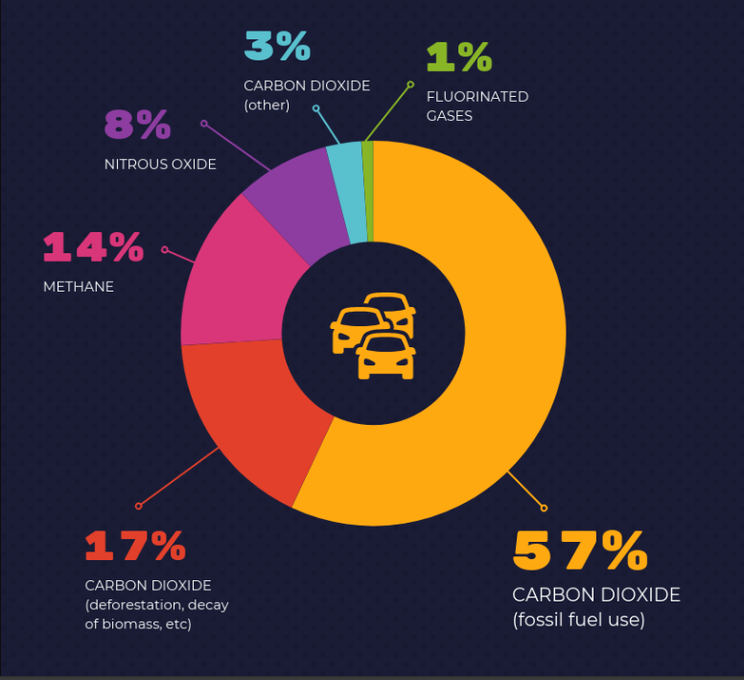

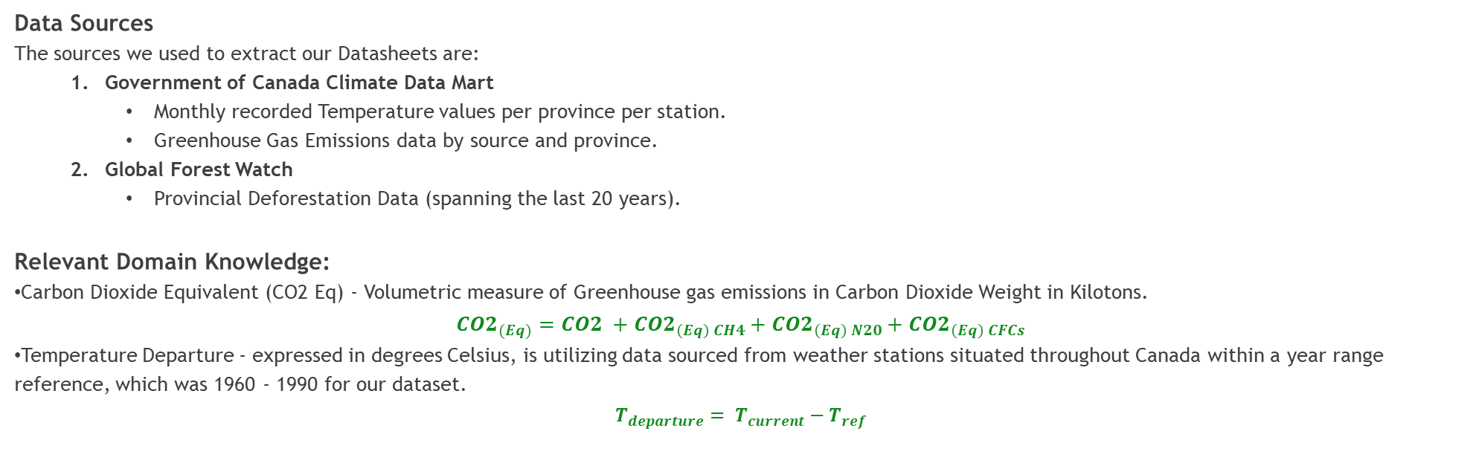
Data Sources & Domain Knowledge
Data Sources
The sources we used to extract our Datasheets are:
Government of Canada Climate Data Mart
Monthly recorded Temperature values per province per station.
Greenhouse Gas Emissions data by source and province.
Global Forest Watch
Provincial Deforestation Data (spanning the last 20 years).
Relevant Domain Knowledge:
Carbon Dioxide Equivalent (CO2 Eq) - Volumetric measure of Greenhouse gas emissions in Carbon Dioxide Weight in Kilotons.
$${CO2}_{(Eq)}={{CO2}_{ }+CO2}_{\left(Eq\right) CH4}+{CO2}_{\left(Eq\right) N20}+{CO2}_{\left(Eq\right) CFCs}$$
Temperature Departure - expressed in degrees Celsius, is utilizing data sourced from weather stations situated throughout Canada within a year range reference, which was 1960 - 1990 for our dataset.
$$T_{departure}= T_{current}−T_{ref}$$

Slide 4
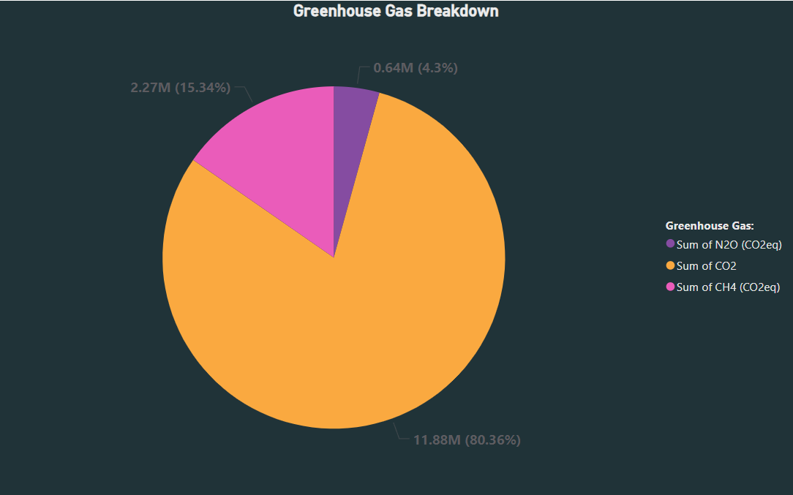
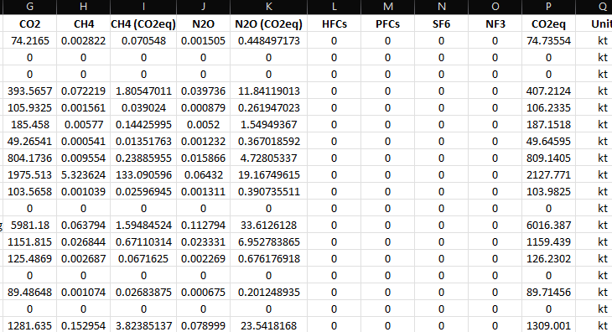
Greenhouse Gas Breakdown

Slide 5

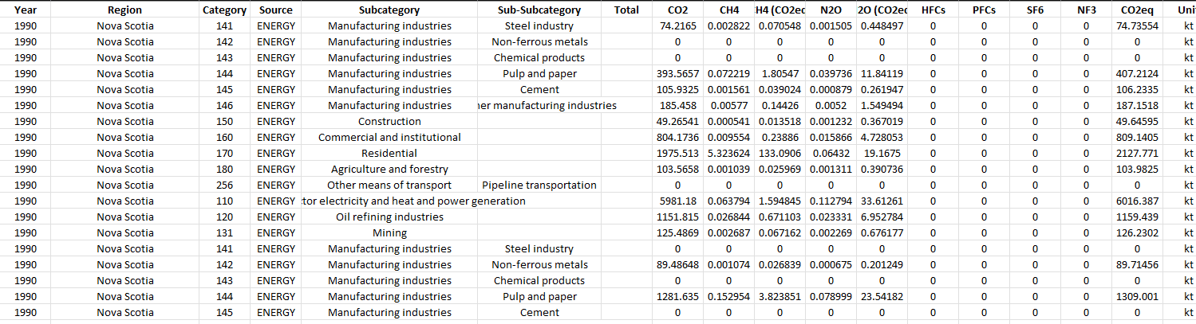
Data Manipulation
Data Manipulation/Transformation:
Examples of data that was extracted which needed to be summarized and transformed:
Provincial Temperatures were transformed to Provincial Yearly Temperatures (which applies to Minimum, Maximum and Mean Temperatures of the respective station(s)).
Deforestation data was transformed to analyze the average tree loss over all canopy thresholds.
Greenhouse Gas data was summarized (Emissions were totaled over all the sources per province as CO2 eq).
Data Cleaning & Prep:
Missing & Null Values.
Aggregation by grouping (Region & Year).
Data scraping on Python for over 100+ datasheets.
Notes:
Remove Challenges

Slide 6
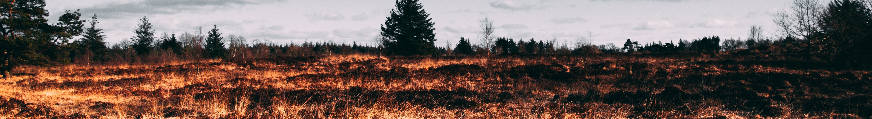
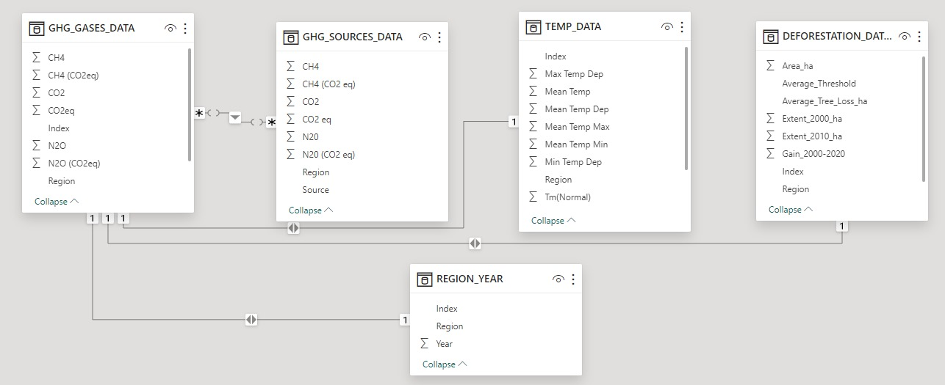
Data Modelling

Slide 7
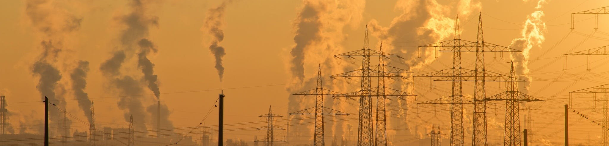
Climate Change Analysis

Slide 8
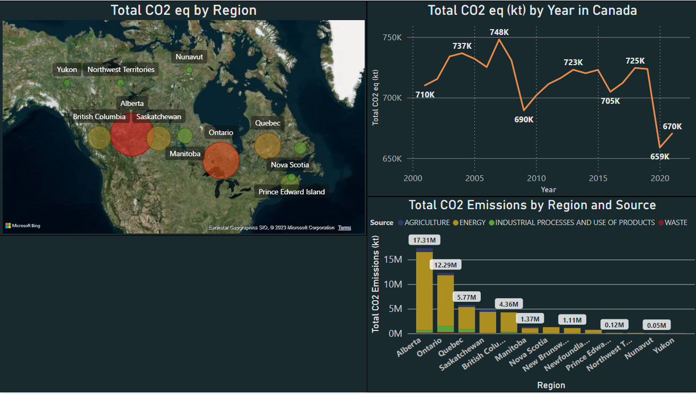
CO2 Emissions across Canada and their sources
Observations:
Alberta has the highest emissions in Canada. While Yukon has the lowest emissions which would coincidence with the regional size.
There is a downward trend of CO2 emissions beginning at 2008, which may be due to the Kyoto Green Agreement.

Slide 9
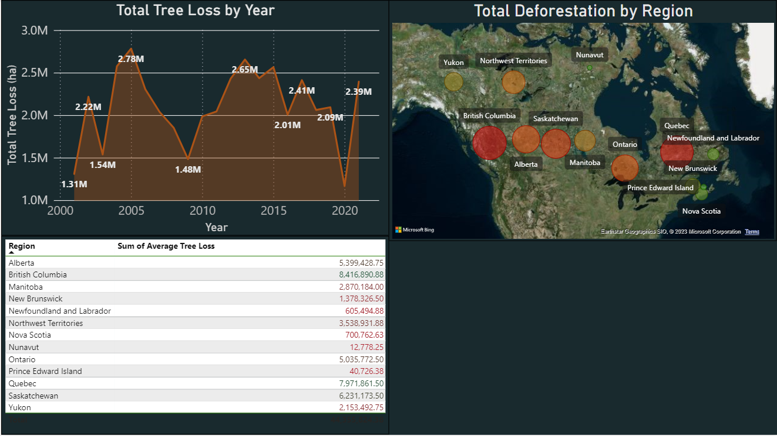
Deforestation/Tree Loss across Canada
Observations:
British Columbia has the highest tree loss density in Canada. While Prince Edward Island has the lowest emissions which would coincidence with the regional size.
There is a downward trend of Tree loss beginning at 2008, which might attribute to the Kyoto Green Agreement.

Slide 10
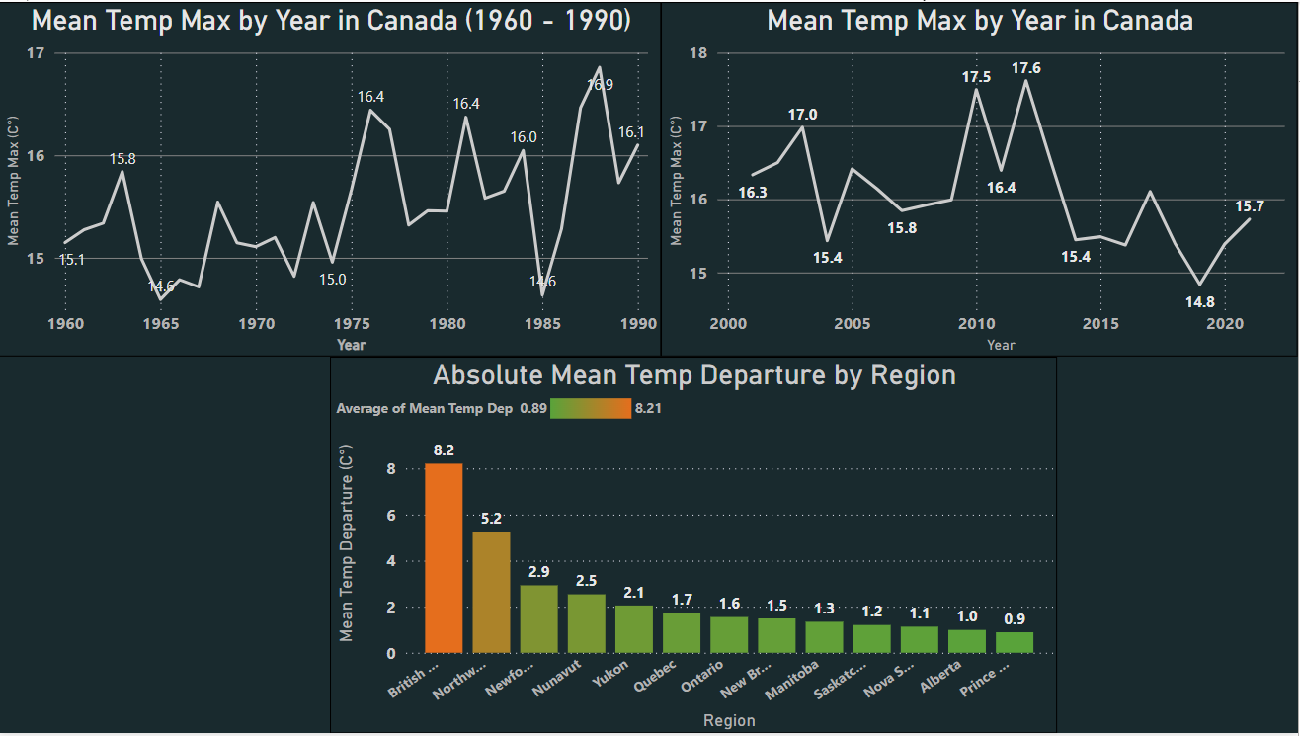
Temperature Fluctuations and Departures in Canada

Slide 11
Analyzing the trends in Canada
……

Slide 12
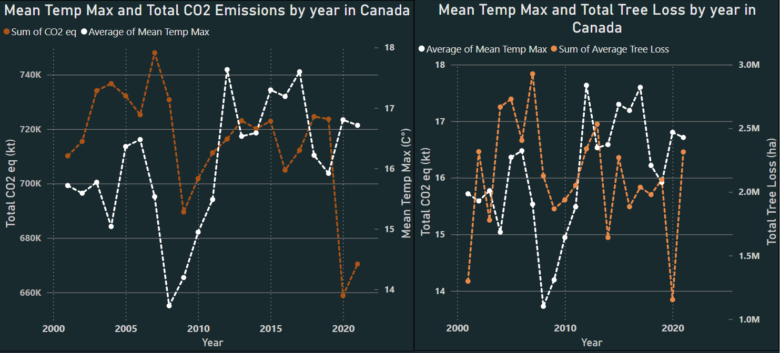
Temperature, Deforestation and CO2 Emissions

Slide 13
Analyzing Sample Regions
……

Slide 14
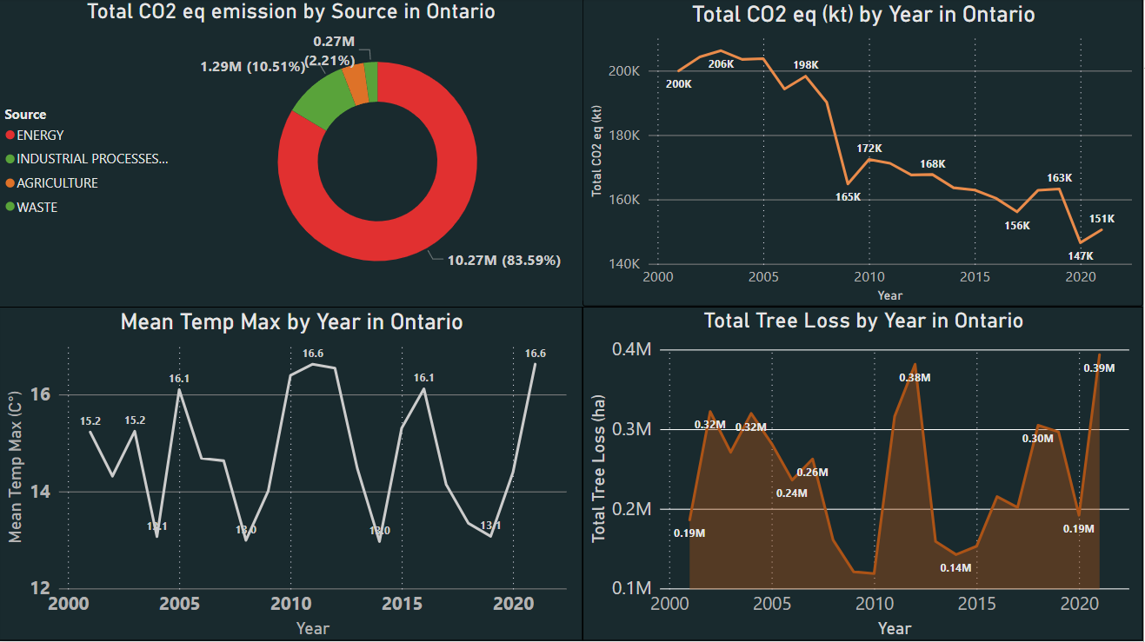
Analyzing Regional Fluctuations ON

Slide 15
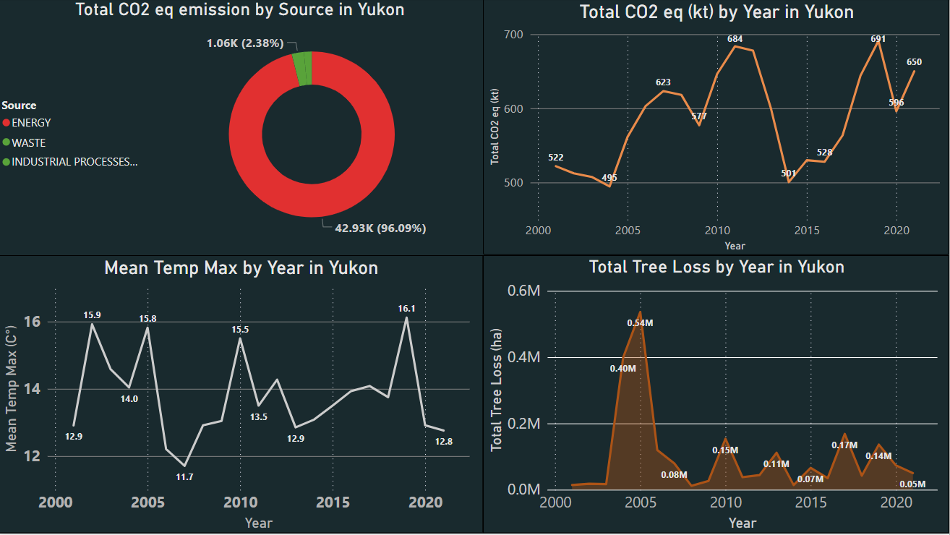
Analyzing Regional Fluctuations YU

Slide 16
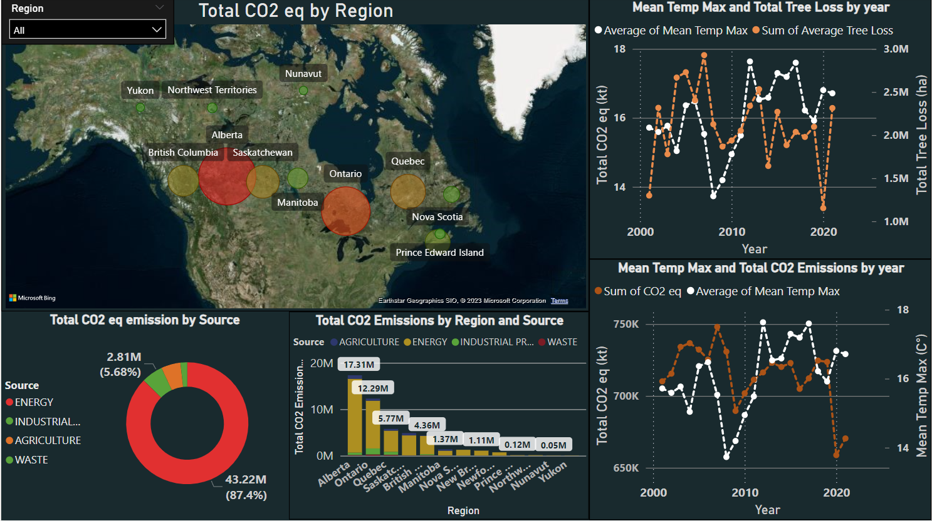
Final Dashboard

Slide 17
Predictive Modeling
……

Slide 18
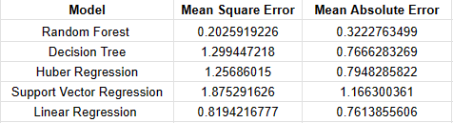
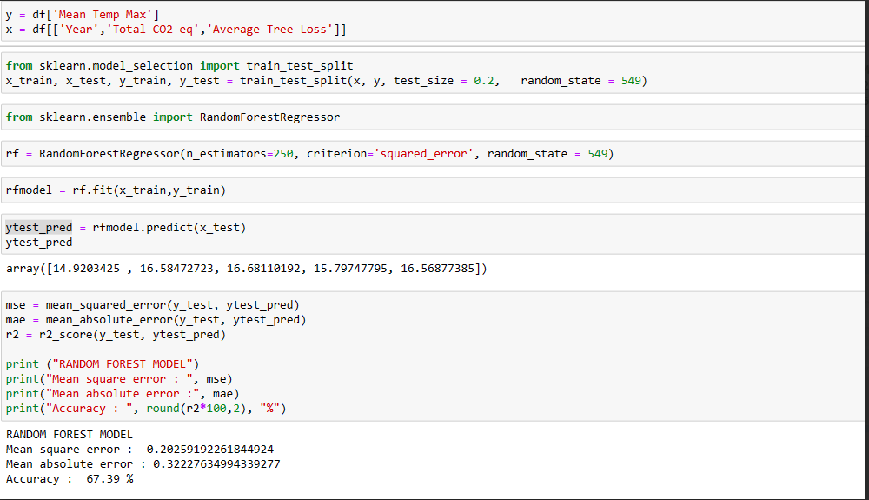
Predictive Model Results
Accuracies of Models
Training (Random Forest)

Slide 19
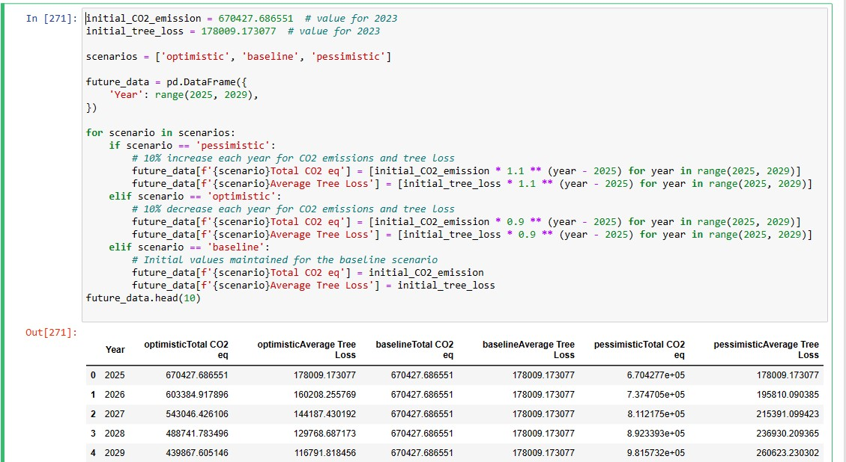
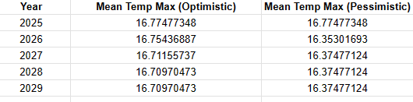
Predictive Model Results
Preparation of Future Data
Predicted Result

Slide 20

Conclusion
After Analysis:
Climate Change is gradual. However, there is evidence that Canada is attempting to reduce it’s Carbon Footprint.
Carbon Dioxide and Deforestation do effect climate adversely. However, Carbon Dioxide Emissions and Deforestation are not entirely sufficient to predict Temperature.
Recommendations and Improvements:
Include more factors of Climate change into our Analysis
Increase the Analysis and predictive timeframe (100+ years).

Slide 21

Thank you!

